Slide 1
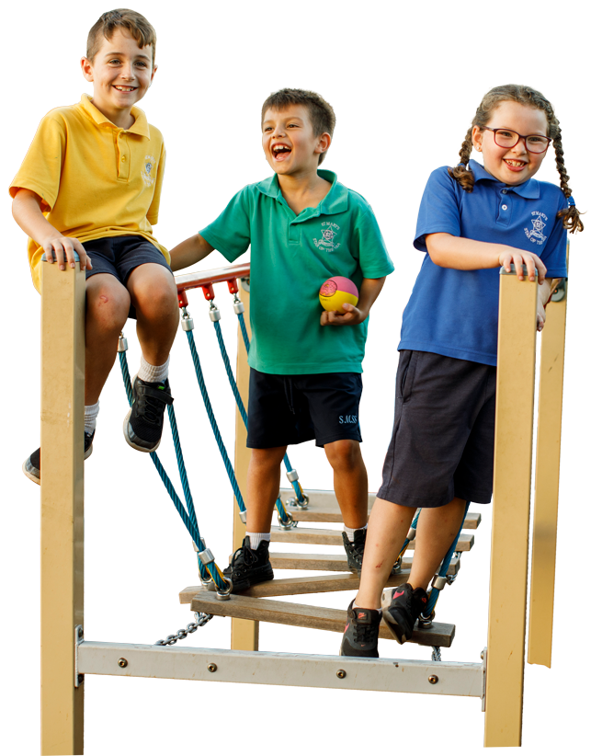
^{Partnership & Community}
^{Your OSHC Activities}
^{Parent & Licence Fees}
A true extension of your school and community, also supporting with school events, fund raising and orientation.
Engaging programs that include exciting and varied activities and components of your school’s curriculum.
A tailored model that offers a competitive return for your school whilst providing affordable care for your community.
^{Investment in Your School}
^{Your OSHC Team}
^{Safety & Security}
An annual budget to invest back into your school’s facilities and community.
A dedicated qualified Coordinator to lead the team every day.
Child safety and security, our number one priority.
^{Your OSHC Support}
A dedicated team of experts that are always available for you.

