Slide 1
Business Managers Victoria Conference
May 2019

Slide 2
INTRODUCTION
School Finance Liaison Officers
Recognition of the need for additional support to School
4 additional positions advertised and filled late last year
1 Manager
3 Additional SFLO’s across the State – total of 7 plus 1
Areas are defined mostly by regions but some SFLO’s cross up to three regions
Notes:
For more detailed information on these changes see: CASES21 Finance Business Process Guide Section 5: General Ledger
CASES21 V58 Release Notes: https://edugate.eduweb.vic.gov.au/newsevents/schoolbull/Pages/CASES21-2017-upgrade.aspx
General Ledger Journals (V59)
Discuss options and how it should be used or shown
CASES21 V59 Release Notes: https://edugate.eduweb.vic.gov.au/Services/bussys/cases21/Upgrade%20and%20Release%20Notes/Forms/AllItems.aspx

Slide 3
CASES21 Finance and Policy Support
School Finance Liaison Officers
The SFLO’s main role is to provide support and guidance to schools on financial management including new principals, business managers and finance committees
Assistance with cash budgets and reading reports
Repayable cash flow assistance
Internal controls and compliance with financial policy, processes and best practices
School Purchase Card briefings
The SFLO’s run information sessions and new business manager sessions during the year to share current and new finance information
Finance Matters –Budgets and Financial Reporting
The SFLO's role is not to complete financial transactions or prepare reports on behalf of the school, but rather to identify any problems and refer schools to appropriate support, such as the CASES21 Finance Process Guide, refresher training or the Service Desk.
Notes:
For more detailed information on these changes see: CASES21 Finance Business Process Guide Section 5: General Ledger
CASES21 V58 Release Notes: https://edugate.eduweb.vic.gov.au/newsevents/schoolbull/Pages/CASES21-2017-upgrade.aspx
General Ledger Journals (V59)
Discuss options and how it should be used or shown
CASES21 V59 Release Notes: https://edugate.eduweb.vic.gov.au/Services/bussys/cases21/Upgrade%20and%20Release%20Notes/Forms/AllItems.aspx

Slide 4
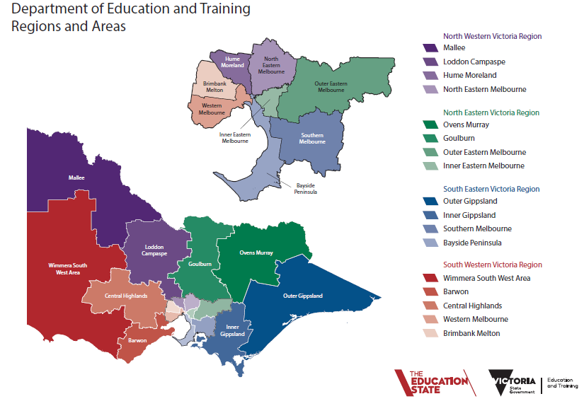
Notes:
For more detailed information on these changes see: CASES21 Finance Business Process Guide Section 5: General Ledger
CASES21 V58 Release Notes: https://edugate.eduweb.vic.gov.au/newsevents/schoolbull/Pages/CASES21-2017-upgrade.aspx
General Ledger Journals (V59)
Discuss options and how it should be used or shown
CASES21 V59 Release Notes: https://edugate.eduweb.vic.gov.au/Services/bussys/cases21/Upgrade%20and%20Release%20Notes/Forms/AllItems.aspx

Slide 5
What are financial commitments?
Financial commitments are identifying the intended purpose of the schools accumulated funds, including an appropriate school operating reserve
The Department’s policy requires schools to report their financial commitments to:
School Council
School communities
DET
Financial Commitments are therefore a reflection of the school’s:
Short and long term plans
Budget
Cash flow
Operating reserve
It is important for schools to link all available school funds with educational opportunities that will benefit students in the year the funding is received.
The majority of funds received have a purpose

Slide 6
Financial commitments
As part of the End of Year process in CASES21 schools are required to report these Financial Commitments
Schools must enter the commitments into CASES21 before running End of Year task
Financial Commitments are identified from the funds that are held in the school bank accounts
Part of the budget process each year is identifying these financial commitments

Slide 7
Financial commitment summary report
What is it designed to tell us?
The purpose we are holding funds in the bank
How and when those funds will be spent
An alert if schools are in a deficit position
Who cares?
School Council – expectation that it will be a component of the indicative budget
School Community – reported in the Annual Report
Transparency of the utilisation of funds for school community
Department – indication of intended expenditure to report

Slide 8
Financial commitment summary report
Why the changes to the Financial Commitment Summary Report?
Greater clarity why schools are accumulating funds
Growing bank balances in previous years
Greater transparency to school communities
Assistance for planning within schools
Start the discussions
Work with the School Council/Leadership teams
Account for funds accurately in the school budget

Slide 9
Financial commitment summary report
Financial Commitment Summary will automatically populate the total of all bank accounts held at the school.
Other pre-populated amounts are :
Operating Reserve – (average of 2 months of expenditure)
Other recurrent expenditure (Accounts Payable on Balance Sheet)
102 Provision Accounts (LSL provision)
Figures in the final Financial Commitment Summary Report will be included in the school’s annual budget for the preceding year – (except for capital works projects greater than 12 months)
The final Financial Commitment Summary, printed as part of the CASES21 Finance End of Year procedure, must be reviewed and signed by the principal and the school council president then tabled at school council.
Notes:
The Benchmark for the Schools Cash Reserve (School Operating Reserve) provides for a safety net of available funds that schools are required to keep uncommitted to meet their day to day financial obligations. This amount is calculated automatically by obtaining the average of two months school calendar year recurrent expenditure (from a school’s Operating Statement GL21150) adjusted for expenditure on ‘Building Works (86504)’, ‘Ground Works (86505)’ and non-cash expenditure items such as ‘Asset Write Downs (89591)’.

Slide 10
CASES21 – Financial Commitments Summary Report
Where do we find the information to populate this report?
The current year’s sub-programs that have funds for specific purpose that should be carried forward
Fundraising - revenue v. expenditure
Shared Arrangements
Funds from KLA areas that have been agreed to carry forward
Planned capital works and purchases
Capital works that will be completed in the following year
Accumulated long term agreed capital works funds
Revenue in advance
Revenue that has been collected prior to the end of the year
CSEF Funding that remains unallocated
Recurrent expenditure
Provision accounts

Slide 11
CASES21 – Financial Commitments Summary Report
If you have reported it on your budget, it should be reflected. For examples:
Fundraising - funds need a purpose prior to the activity – carried forward balance should reflect agreed spend (e.g. books for the library, iPad for the classrooms,
Program areas that have put in submissions to carry funds forward for a reasons – expenditure budget should include agreed expenditure in addition to carried forward figure
Shared arrangements for Principal/Sports Association Networks
Capital works that will be completed in the following year
Exceptions
Long term capital works funds that are being accumulated should not be allocated an expenditure budget in the following years sub-program
Deficit in SRP credit – it is not an expenditure, it is a loss of revenue

Slide 12
CASES21 – Financial Commitments Summary Report

Slide 13
CASES21 – Financial Commitments Summary Report
What it is not:
It is not a report for the following years current budget
It should not have any expenditure commitments against Sub-Program 9499
It’s not a report to reflect your BDA’s
It is not a report to display expenditure that has not been planned, discussed and reported to School Council. For example:
would you want your school community to read about the intended gymnasium extension in the Annual Report?

Slide 14
CASES21 – Financial Commitments Summary Report
How can we make it better?
Report only on true commitments
Display your accurate financial positions –
we are in a financial deficit (commitments greater than funds).
we do have a surplus – let’s work on how we planned to use those funds effectively.
Make use of the comments box.

Slide 15
Contact details for SFLO’s
Julie Evans - North-Eastern Victoria
Phone: 0448 431 463 evans.julie.A2@edumail.vic.gov.au
Anne Gregory - North-Western Victoria
Phone: 0437 179 867
gregory.anne.k@edumail.vic.gv.au
Kerry Hanrahan - Inner West/North/Inner city
Phone: 0436 000 256
hanrahan.kerry.k@edumail.vic.gov.au
Cathy Mahoney – South-Eastern Victoria
Phone: 0438 773 928
mahoney.catherine.m@edumail.vic.gov.au
Fiona Missen - South-Western Victoria
Phone: 0417 003 172
missen.fiona.m@edumail.vic.gov.au
Chris Symec - Inner North-Eastern Victoria Phone: 0400 052 819
symec.christine.a@edumail.vic.gov.au
Carol Tolley - Inner South-Eastern Victoria
Phone: 0455 345 921
robinson.glenice.j@edumail.vic.gov.au
If you are unclear of who your SFLO is please contact Barb Martin, Manager
Phone: 03 7022 2231
martin.barbara.l@edumail.vic.gov.au
Notes:
e.g. - a school run canteen provides catering for Professional Development session. The journal will reduce the expenditure for the canteen budget and increase expenditure in the P.D. budget (see example below)
Journal the GL code for Trading Operations Canteen to the P.D. budget so it relates the expense to the canteen
Journal the Trading expense to Professional Development Sub-Program
Ensure the Professional Development sub-program has a budget line for trading that is associated with the catering cost.
The detail needs to be meaningful so the canteen can identify which team was charged and that the PD co-ordinator is aware of why there is a trading expense against their sub-program.

Slide 16
THANK YOU FOR ATTENDING
16

