Slide 1
The Central Banking System Implementation of Global Best Practice March 2019
Notes:
Bill does a welcome and introduces the entire CBS Project Team (DTF, TCV, Westpac). DTF runs through the slide deck but engages TCV and Westpac for discussions

Slide 2
Agenda
Background to the Central Banking System (CBS)
Working Capital Project
Government’s policy decision
Central Banking System implementation
Questions

Slide 3
Background to the CBS
The Government wanted to review if cash (working capital) resources were being managed efficiently.
Treasurer commissioned Ernst & Young (E&Y) to review the efficiency of Working Capital management.
In May 2017 the findings were presented to Cabinet. In its findings E&Y concluded:
approach to cash and banking was very decentralised in contrast with other states and large corporates; and
material cost impact on the budget.
Borrowing and Deposit rates
Budget borrowings
Agency bank accounts

Slide 4
Working Capital Project
Cabinet (PSBC) requested the Department of Treasury and Finance (DTF) to identify a model for implementing a Centralised Banking System.
DTF established the Working Capital Project.
DTF completed a bank and investment account survey for all operating / investment accounts:
over 8,500 bank accounts across the General Government sector (including term deposit accounts).
Advantages of the approach:
cash funding model to provide funding certainty to departments and agencies for spending; and
flexibility to choose transactional banker to provide tailored outcomes.

Slide 5
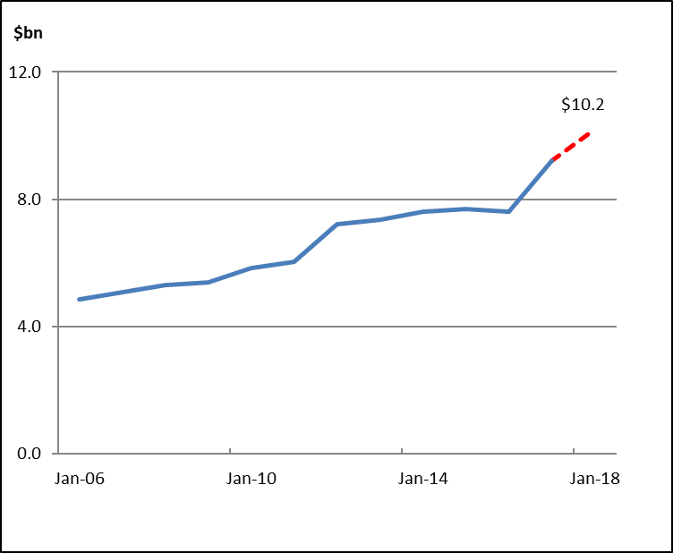
Government’s policy response – Establish a CBS
Holdings of surplus funds on the General Government (GG) sector are large, and growing.
GG Sector Financial Assets
The potential benefit to the Budget of centralising funds held outside the CBS are estimated to be around $125 million when fully implemented and funds fully utilised.

Slide 6
Central Banking System
DTF recommended an operational model for a CBS. This model was approved by the Treasurer in late 2018.
Eligible Financial Assets (surplus funds) held by agencies is limited to depositing in the CBS:
accounts held with the State’s banker – Westpac. Previously funds had to be held with Treasury Corporation of Victoria; and
for most schools, this meant simply linking existing Westpac accounts.
CBS accounts continue to be paid a market based interest rate.
Transactional bank accounts can continue to be held with another bank.
Policy amended:
ability to hold $2.0 million outside of the centralised system removed; and
minimal balances to be held in a transactional bank account.

Slide 7
Central Banking System – impact on schools

Slide 8
Central Banking System – continued flexibility
The CBS is centrally managed. This allows the State to achieve $125 million of savings whilst preserving the current benefits for agencies.
Central account, but the timing of expenditure continues to be at the discretion of the schools.
Transactional accounts can be maintained:
with your current bank as long as balances are kept to a minimum; and
need for schools to use a local bank in their community recognised.
Locally raised funds do not have to be held in a CBS account.
Attractive accounts features include:
At call
Reserve Bank cash rate plus 40 basis points
significant advantages of the State’s banking services contract
same Westpac account arrangements.

Slide 9
Questions

Slide 10
Attachments

Slide 11
CBS is an off-set arrangement
The CBS enables interest expense savings as long term debt can be repaid by off-setting surplus funds held by agencies in CBS Accounts.
One Account Agreement with Westpac
Interest savings by reducing long term debt

