Slide 1
Next Generation Schools’ Administration Program
March 2019

Slide 2
Key Points of interest for you
Information on the Department’s new Student and Schools Administration Platform
Wider provisioning of Services and Functionality for BMs & other users
Modern platform and more efficient system: reduced burden on BMs
Protection & Privacy of Information
Considerations of ‘System of Record’ versus ‘3rd Party Applications’
How you can be engaged
The journey has started

Slide 3
Background
Status
Student & school administration is a vital enabler to the operation of a school and supports students, families and school staff. The ‘system’ consists of the policies, processes, information and technology.
Since the late 1990’s the Department has provided a commercial product called MAZE (known as CASES21). The CASES21 system is hosted in all schools and is using a client/server based technology, to provide:
  Student administration (e.g. enrolment, attendance) &
  School management (e.g. finances, accounting etc.)
There are growing imperatives to provide schools with a modern, intuitive and technically sustainable system.
Requirements for the collection, handling & sharing of information have grown and become increasingly complex.
Existing practices and technology are aging and no longer adequately support the current and emerging needs of schools and their communities, while
Student and parent/carer/guardian (P/C/G) expectations of engagement with their school are increasing
Department Intent
Initiated the student and schools Next Generation Schools Administration Program (NGSAP)
NGSAP will deliver a modern, streamlined and contemporary Student & Schools Administration Platform for the more efficient delivery of, and access to, a broader range of services & functions
is taking a very considered approach to NGSAP; building a foundation platform that can be built upon over time
acknowledges this as a significant business improvement step for schools & staff. Has assigned a significant proportion of the planned resources to the support of schools during the transition.
Progress:
Business Case prepared; DET Executive Board has approved (Dec 18); Awaiting submission to Government.
Department Treasury & Finance: Gate 2 Finding - “Presents a strong case… for a modern solution” (Dec 18)
Preparing submission for Procurement & Probity Committee decision (in progress).

Slide 4
Program Aim
The Next Generation Schools Administration Program (NGSAP) aims to meet the needs for improvement to the Victorian schools administration system through investment in policy, practice and technology reform.
The platform will:
  be modern, intuitive
  be an enterprise-wide cloud based information management system
  maximise opportunities for automation
  ensure protocols for protection and privacy of information
  facilitate improved executive reporting with greater consolidation of information into the platform as the single source of truth
  be integrated with other departmental systems to ensure the best opportunity for alignment of policy and practice.
The NGSAP will provide all government schools with:
  a student-centric data structure ensuring the student as the ‘foundation’ of the information hierarchy
  more efficient transactional processes with a wider suite of functions & services
  clearer alignment between Policy, Practice and Technology. Will encourage greater collaboration between the Department and Schools and minimise the need for Schools to invest in 3rd party applications
  a central repository for students and schools’ administration available anywhere, anytime and on any approved device providing a means of collaboration and synergy between schools, regional and central staff
  Information exchange built upon the National Schools Interoperability Framework, SIF standard
  a consistent digital service enabling engagement and collaboration with parents/carers/guardians.

Slide 5
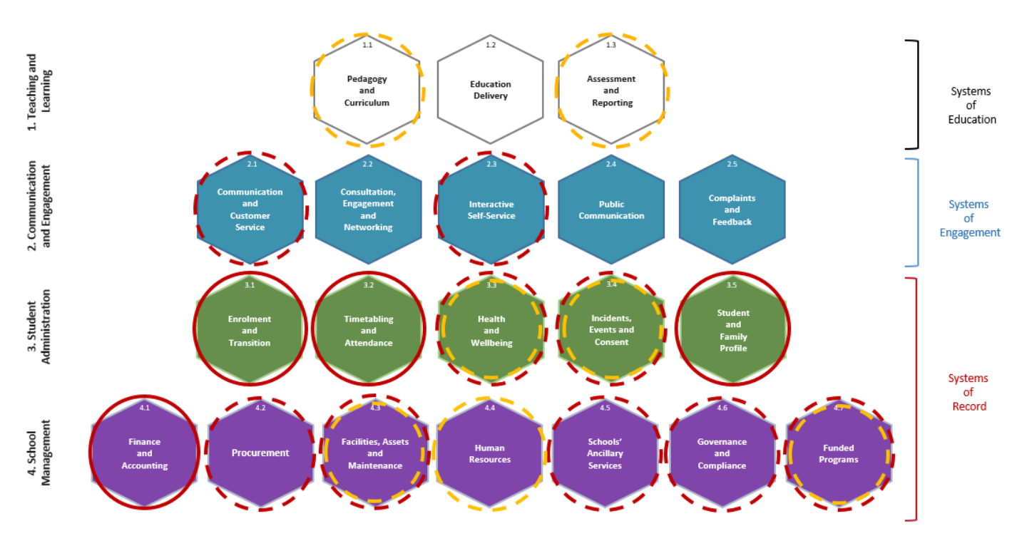
Scope
The School Services Model contains a collection of services, sub-services and processes specific to a particular segment (hexagon). All items in scope for delivery of Stage 1 of the NGSAP are highlighted in the below diagram as per the legend below:
Foundation Capabilities Foundation/Additional capabilities Information integration with other systems

Slide 6
Schools’ Services Model
The Schools’ Services Model is a way of segmenting all of the services and functions that a school performs in a simple and easy to understand manner.
Each ‘hexagon’ contains a collection of services, sub-services and processes specific to that segment.

Slide 7
NGSAP: Engineering the Requirements
Jan-2019
July-2019
Apr-2020
Domain
Service
Function
Sub-functions
Processes
Use Cases, Scenarios
Business Rules
Policy and Practice Gap
Opportunity
Problem
BRS, SOW
Requirement Statements
Draft contract and vendor engagement

Slide 8
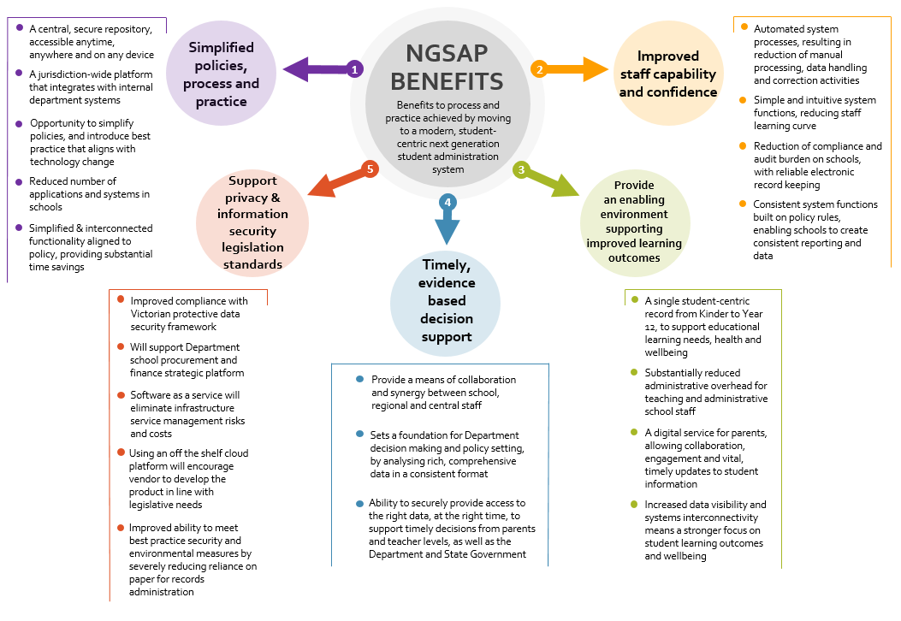
Benefits Realisation
The NGSAP investment will bring positive change to students and schools’ administration process and practice enabled by improved technology platform.
The Program is working to shift the view of the existing education system to a student-centric perspective.

Slide 9
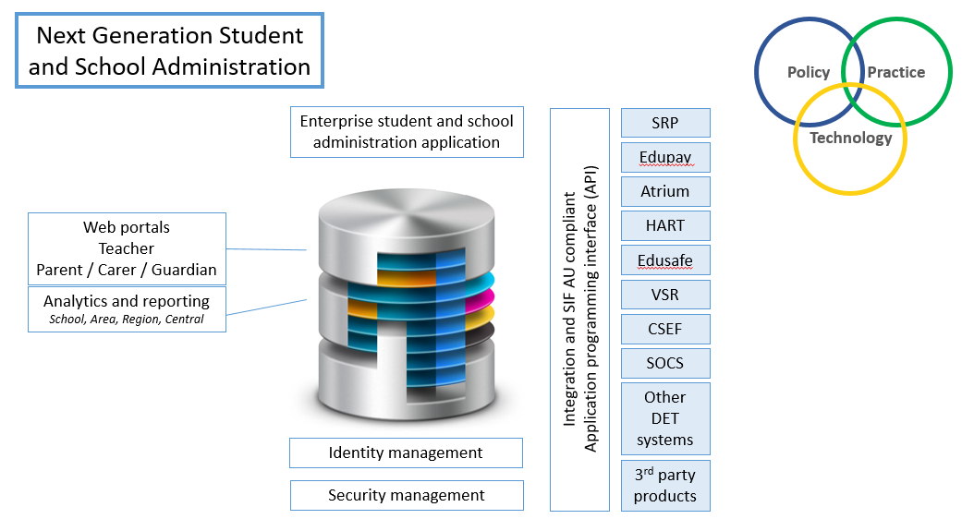
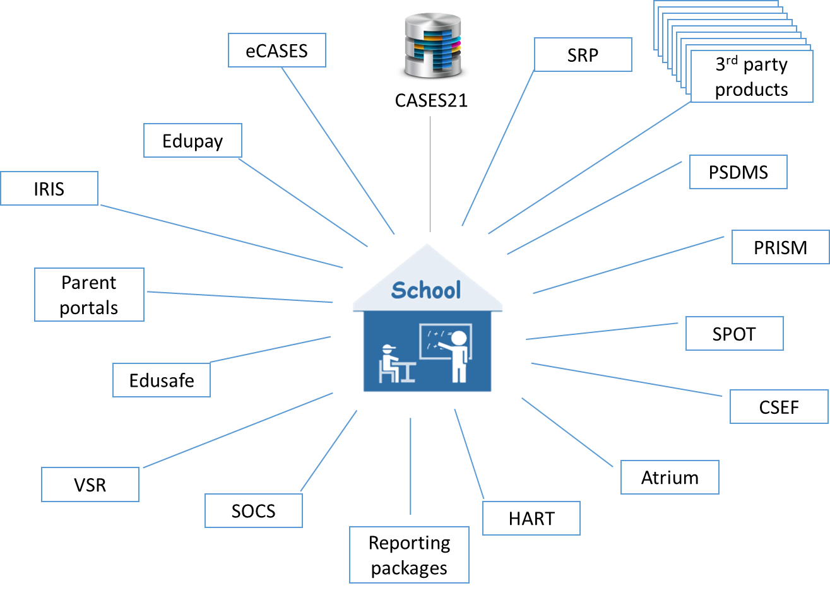
NGSAP System Requirements – Benefit Examples
P/C/G Information Portal (comms audit trail: consents, merit events etc.)
Notifications (fees, excursions etc.)
On-Line: Enrolments, fee payment etc.
Timetabling (& student portal)
Updates to and visibility of student and family information
Synchronicity across finance, P/C/G & student profiles
Teachers can automatically reconcile student lists
Configurable Secure System – Supports Collaboration
Alignment of Policy & Practice
Single System of Record
Single Logon
Cloud based: accessible anywhere anytime via’ appropriate devices
Improved information integration across departmental systems
Timely Decision Support: Modern IT Platform
Improved Processes & Practice:
Wider range of
services
& functions
Department sponsored administration system
Equitable provision to all schools
Automated Processes
Common knowledge base across user community
Enabling Environment: improved efficiencies supporting learning
Improved Capability & Confidence
Department & Systems
Protection & Privacy Protocols (VPDS)
Standards for Systems Security
Student centric data structure
Single student – P/C/G accounts & profiles
Data entered once into System-of-Record
Single information repository
Information Confidence: Reporting, Quality, remove duplication errors
Privacy & Info Security:
Information Management Provisions
More efficient E2E transactions
Alleviate administration burden & cost overheads
Improve focus on educational leadership
Limit the widening gap: Departmental system to 3rd party applications.
Improved experience: Principals, BMs, admin / central staff
Automated scheduling & alerts for processes (e.g. student support plans)

Slide 10
Stakeholder Groups
A key factor in the effective delivery of the change and communication strategy is in the identification of stakeholders. Opportunities for improvement to business practices by user community are assessed as:
Above: Impact of change scale

Slide 11
Stakeholders can be engaged in a number of ways:
Generally represented by:
School Practitioners: Business Managers and Principals. (‘hands-on’ knowledge: school operations, policy, processes & technology).
Regional Leadership: (Inc. RSG Central). Support schools. Bridge policy, practice and program areas.
Central Leaders: DET central business streams. Typically Business & Policy Owners: definition & measurement.
As Subject Matter Experts:
Provide advice on and review of business requirements and program artefacts
Advise and recommend policy, process, solution change and/or improvements
Be an advocate for change
At What Points Can I Be Engaged?
SMEs Participate at key NGSAP milestones:
  Requirements Definition
  Process & System Design
  Process & System Testing
  Operate the system in Pilot
  Rollout & Planning: Advocate for change
We will be looking for SMEs that can be directly engaged, as well as an extended community prepared to peer review key artefacts.
What Can I do to be Ready?
Each School can prepare, or participate in, the following:
  Current Practices: review & improve? Training needed?
  Current Data & Information: Cleansing activity
  Consider future of school operations and roles etc. in light of proposed new capabilities
  Plan school level transition advice
  Quick Win ideas to CASES21 & NGSAP (where appropriate)
  Remain Engaged: NGSAP web site, info sessions
EOI for BM

Slide 12
NGSAP Strategic & Dependent Work Streams

Slide 13
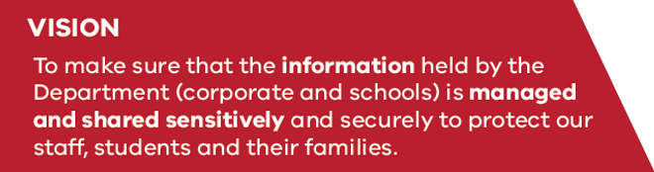
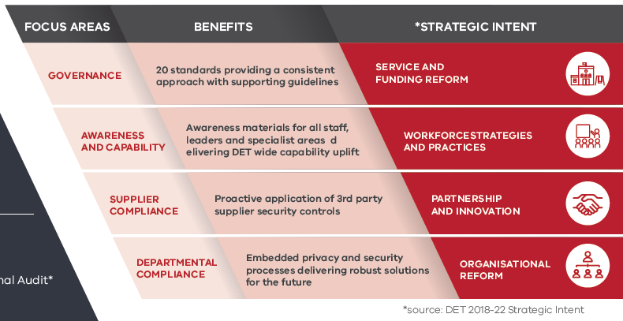
DET InfoSafe Program
Protecting our Information
Notes:
The program vision is to make sure that information held by the Department (corporate and schools) is managed and shared sensitively and securely to protect staff, students and their families.
The InfoSafe program is informed by privacy and data protection legislation as well as child information sharing legislation.
It reflects two reference frameworks - the Victorian Protective Data Security Framework (VPDSF) and the DET Privacy Assurance Framework:
The VPDSF was introduced by the Office of the Victorian Information Commissioner (OVIC) in 2016 and amended in March 2018.
The DET Privacy Assurance Framework was developed in 2018 to provide context for the actions outlined in the Privacy Action Plan developed in response to a significant privacy breach experienced by the Department in 2017 around its public consultation process.

Slide 14



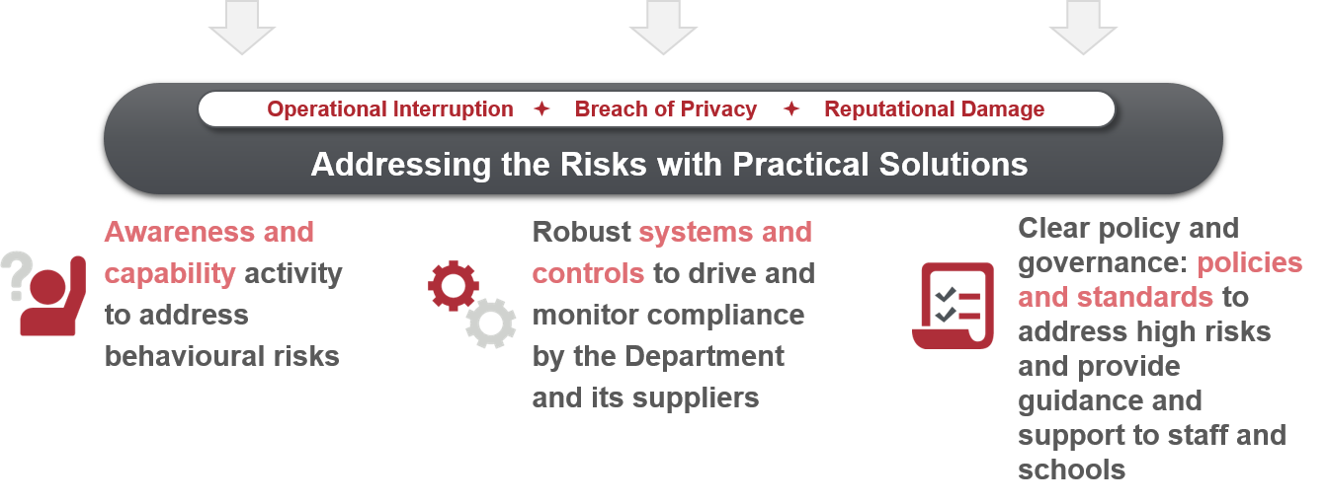
Staff Behaviours
Cyber Attacks
Student Behaviours
Our breaches are typically caused by:
Non complex passwords
Accidental behaviours (saving)
Risks in the digital landscape typically come from:
Phishing
Ransomware
Poor Controls
Risks by ‘tech savvy’ students caused by:
Exploring
Accidental
Intentional
Lack of awareness
Mobile Devices
Understanding the Threat Environment
Notes:
Awareness and capability activity to address behavioural risks
A campaign of clear and regularly reinforced communications to schools and school-based tech staff
Deep engagement – for example a program of visiting schools identified as high risk (generally secondary schools). InfoSafe includes teams of people who understand the school setting and work with them to ask four basic questions: “What sensitive information do you have? Where do you store it? How is it protected? Does everyone at the school understand that?
Training, e-learning, induction processes
Information Awareness Month activities
Raising awareness of staff to the risks of phishing attacks (90% of cyber security attacks start with a scam email) through a multi channel communication campaign
Robust systems and controls to drive and monitor compliance by the Department and its suppliers
Conditions of Connection framework to assess vendors of third party software against standards
lifting awareness among staff on appropriate password management and introducing 2 factor authentication (as used in online banking apps) to those areas of Compass that hold sensitive data. This will minimise the risk of leakage of sensitive Compass data that causes harm and distress to school communities .
introduction of a security compliance process for any 3rd party technology procured by schools that may hold sensitive data
Clear policy and governance – policies and standards to address high risks and provide guidance and support to staff and schools.
Integrated delivery of the InfoSafe program which links privacy, information security and child information sharing activity
Guidance on where and how to save sensitive information safely
Guidance on what to do if a breach or incident occurs
Guidance for schools on the risks that engaging 3rd party suppliers can carry.

Slide 15







Working Together to Build an InfoSafe Culture
Building User Guides
Awareness on ‘What’s Sensitive’
Testing Streamlined Admin Rights
Tiering of 3rd party suppliers
Endpoint Security Pilot
Current opportunities
to get involved
...and join the conversation on Yammer
Contact us: InfoSafe@edumail.vic.gov.au

Slide 16



InfoSafe Outcomes
InfoSafe will support Business Managers with clear guidance and awareness materials highlighting key focus areas to efficiently reduce school level risk.
Notes:
To affect the desired cultural change, an awareness campaign is being developed that is centered around the simple steps everyone at the Department can take to minimise information security and privacy risks. A range of supporting awareness materials have already been delivered, including:
Privacy Complaint Handling Process
Managing Privacy in Public Consultations
Privacy Impact Assessment template for schools and corporate
Secure staff exit procedures
Privacy eLearning module for schools
InfoSafe InfoSheet – Social Engineering
Established InfoSafe Yammer community – over 1200 engagement points in 1st month
School specific Information Security Policy and Guidelines .

Slide 17
Further Information
The Next Generation Schools' Administration Program Team look forward to collaborating with you.
Further information on the Next Generation Schools’ Administration Program is available on
NGSAP Your Say site
Please feel free to contact us via our team mailbox:
next.gen.schools.admin@edumail.vic.gov.au

Slide 18
