Slide 1
PULLMAN ALBERT PARK
MAY 8-10, 2019

Slide 2
SCHEDULED: 8-10 MAY, 2019

Slide 3
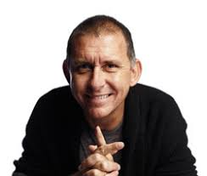
WEDNESDAY MAY 8
REGISTRATION
2.00pm Registrations open, visiting sponsors in the exhibition area
ICE BREAKER SESSION supported by Camp Australia
5.15pm First time conference attendees, Bridges to the Future conference scholarship holders and Interstate guests attending
WELCOME DINNER sponsored by Bank Australia
6.00pm Pre dinner drinks
7.00pm Official opening
School musical performance
AFTER DINNER SPEAKER – PETER ROWSTHORN
Peter is a talented performer and comedian and will engage with us whilst we network with colleagues at our welcome dinner

Slide 4
PROPOSED MASTERCLASSES
PDP GOAL | PRACTICE | KNOWLEDGE | ENGAGEMENT | LEADERSHIP
9.00am | HR & BEST PRACTICE Phil Pearson | SFLO’s Meet the team and discover their abilities | WORKPLACE MENTAL HEALTH Dr Rosemary McCallum | HOW TO LIVE AND WORK MINDFULLY Kate James
10.30am | Morning Tea in the Exhibition Area
11.00am | STUDENT RESOURCE PACKAGE (SRP) Insight and overview of the SRP | SUPERANNUATION Vic Super | UTILISING EMOTIONAL INTELLIGENCE Dr Rosemary McCallum | RETHINKING RELATIONSHIPS Janine Stratford
12.00pm | Lunch in the Exhibition Area
1.00pm | RECRUITMENT ONLINE Full details on the recruitment process | MARKETING STRATEGIES FOR YOUR SCHOOL Emma Jane Hamilton | CREATING BETTER BALANCE Kate James | DEVELOPING THE LEADER IN YOU Janine Stratford
2.30pm | Afternoon Tea in the Exhibition Area
3.00-4.00pm | PLENARY PRESENTATION - SIMON DOWLING Increase your level of influence and collaboration with staff

Slide 5
THURSDAY MAY 10
PHIL PEARSON – DET Policy & Employee Relations:
Phil Pearson will be undertaking a masterclass covering your current HR Scenarios and advice regarding best practice
STUDENT RESOURCE PACKAGE: DET representative, Susan Smith will conduct an overview of the SRP including planner. Will be an excellent insight to the SRP.
RECRUITMENT ONLINE:
If you manage the recruitment process, or new to this this masterclass is for you. Hoping to provide a thorough outline of the recruitment process in schools, along with best practice.

Slide 6
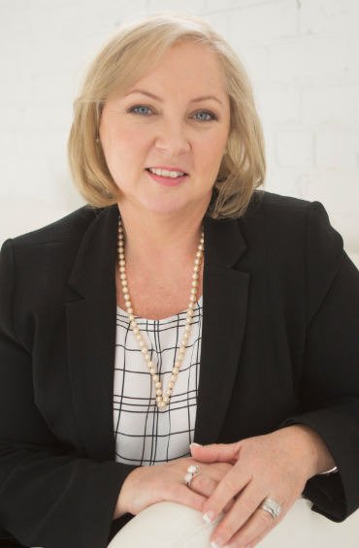
THURSDAY MAY 10
VICSUPER – PLANNING YOUR FINANCIAL FUTURE
Our business partner is facilitating a Superannuation workshop
JANINE STRATFORD
A previous Assistant Principal, Janine is now a Leadership coach and career strategist, working in the education and corporate sector. Her focus is on upskilling and inspiring great leaders of education. She will be undertaking two masterclasses for us:
#1 – DEVELOPING THE LEADER IN YOU
#2 – RETHINKING RELATIONSHIPS

Slide 7
THURSDAY MAY 10
MARKETING STRATEGIES FOR YOUR SCHOOL
This masterclass will provide information on school promotion, increasing public perception and marketing strategies. Learn how to promote your school that ensures maximum benefit to your school and community
DET SCHOOL FINANCE LIASON OFFICERS (SFLO’S)
Their main role is to provide support and guidance to schools in financial management, and this will be a great opportunity for networking with these experts, discussing best practice and process for your school.

Slide 8
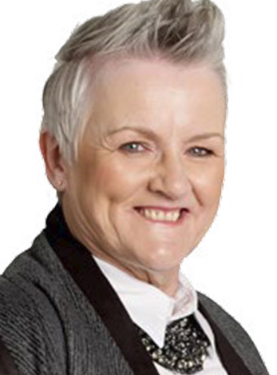
THURSDAY MAY 10
DR ROSEMARY MCCALLUM – UNDERTAKING 2 SESSIONS
#1 HOW TO ENGAGE THE DISENGAGED
Don’t miss this masterclass which offers clear and concise details around on how to look at staff disengagement and strategies around how to address this increasing issue.
#2 UTILISING EMOTIONAL INTELLIGENCE
Emotional intelligence is the ability to identify and manage your own emotions and the emotions of others. This session, will give you greater capacity to manage stressful environments and cope with a balance in work-life activities.

Slide 9
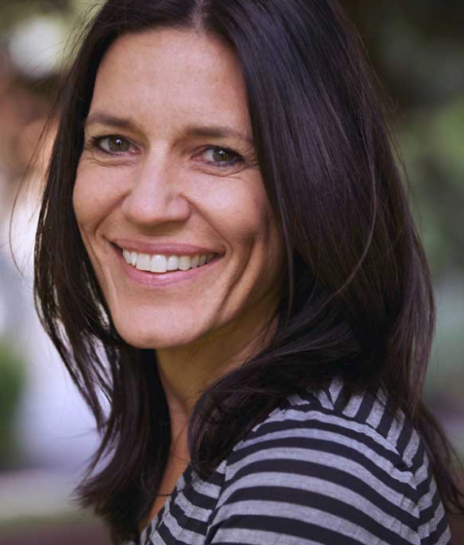
THURSDAY MAY 10
We are pleased to have secured Kate James who undertaking two Masterclasses for us. Kate is an author, coach, mindfulness teacher and speaker:
#1 HOW TO LIVE & WORK MINDFULLY
Become more present and focused, balance negative thinking and identify your personal values. Includes tips on building more positive professional relationships.
#2 CREATING BETTER BALANCE
Learn how to use your time more effectively and cultivate a more mindful approach that will help you reduce stress in your busy life.

Slide 10
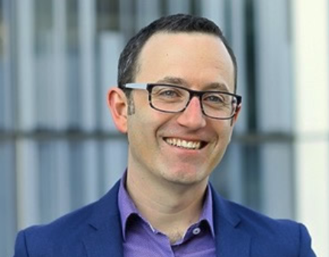
THURSDAY MAY 10
SIMON DOWLING - PLENARY PRESENTATION
COLLABORATION AND INFLUENCE
Simon helps individuals to become highly effective influencers & negotiators, and to build teams that thrive on a culture of collaboration
2019 GALA DINNER EVENT
Our 2019 ABMVSS Leadership Conference will be our 40th (Ruby) Anniversary of this event. To mark this special occasion, our 2019 dinner theme will be…….

Slide 11
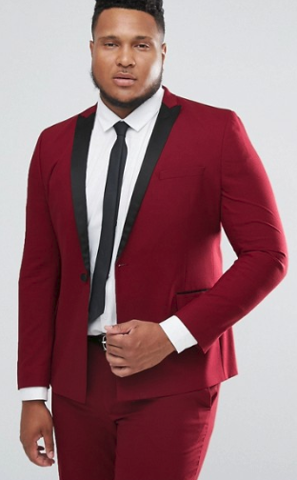
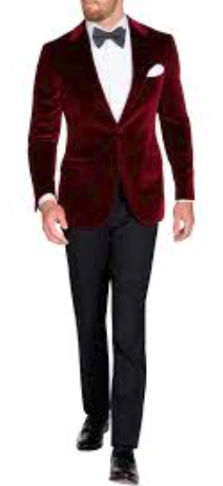
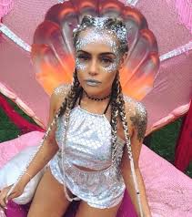
ALL THAT SHINES - RUBY RED CARPET

Slide 12
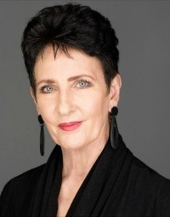
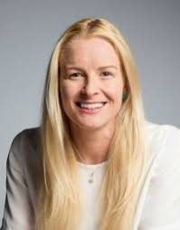
FRIDAY MAY 11
ROBYN MOORE - PLENARY PRESENTATION
BEYOND INFORMED TO TRANSFORMED
A voice over artist for 40 years, she now change’s peoples lives by getting the ‘cut through’ her clients want. Re-ENGAGE, Re-MIND, Re-CREATE, Re-FRESH, Re-DISCOVER
KEYNOTE PRESENTATION
JESSICA GALLAGHER
Jessica is an Australian Paralympic alpine skier, athlete and tandem cyclist. Her inspiring story will challenge you to think differently and see your world from a whole new perspective.

Slide 13
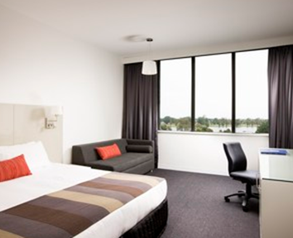
HOTEL ACCOMMODATION OPTIONS
PULLMAN HOTEL ROOMS
Accommodation on higher floors
Level 3 and above
MECURE PREMIUM ROOMS
Premium Rooms on lower levels in the Hotel Pullman side
MECURE HOTEL ROOMS
Mercure rooms on the Mecure side of the hotel complex

Slide 14
CONFERENCE REGISTRATION
BOOK ONLINE: www.abmvss.theconferencemanager.com.au
Any issues registering – email Jacqui@theconferencemanager.com.au
BRIDGES TO THE FUTURE SCHOLARSHIPS: Leadership conference scholarships will be awarded for our 2019 conference.
Thanks to VTMB and Camp Australia
PREFERRED METHOD OF PAYMENT:
Direct Deposit ABMVSS Conference Account
BSB 313-140 Account 23184993
Please check our cancellation policy on the website

Slide 15
YOURS & OUR COMMITMENT
Your commitment: Is to take responsibility for your personal growth and to further your professional learning and continuing to build on your leadership capacity.
Our commitment to you: Is to continue to provide these professional learning opportunities that build on this added value you may have already commenced. Collectively, we will raise the profile of all Business Managers, working strategically in schools - as Education Business Leaders.

